Slide 1

Path2Learn
From Static Syllabus to Smart Learning Path
Team NovaCode | EdTech Innovate Hackathon

Slide 2

The Problem: Disjointed Learning & Exam Stress
Overwhelming Syllabus
Lack of Clarity
Students face an overwhelming amount of information in static syllabi, leading to confusion and burnout.
No clear guidance on what to study first, making effective prioritization extremely difficult.
Scattered Resources
Low Motivation
Learning materials are fragmented across various platforms, causing valuable time to be wasted in searching.
Poor progress tracking and lack of immediate feedback demotivate students, hindering consistent study habits.

Slide 3

Why This Problem Matters
Students often waste precious time planning their studies instead of actively learning.
Lack of structured evaluation leads to poor knowledge retention and superficial learning.
The absence of proper guidance results in increased stress and last-minute exam preparation.
Current educational tools primarily focus on resource delivery, not on guiding topic-wise learning progression.

Slide 4
Our Solution – Path2Learn
Smart Learning Platform
Guided Progression
Assess & Motivate
Path2Learn is a syllabus-driven platform that converts static course outlines into dynamic, actionable learning topics.
We guide students step-by-step through their syllabus, ensuring a logical and effective learning flow.
Integrated quizzes measure understanding, providing instant feedback and recommending the next best topics to study.
Path2Learn empowers students to take control of their learning journey with clarity and confidence.

Slide 5
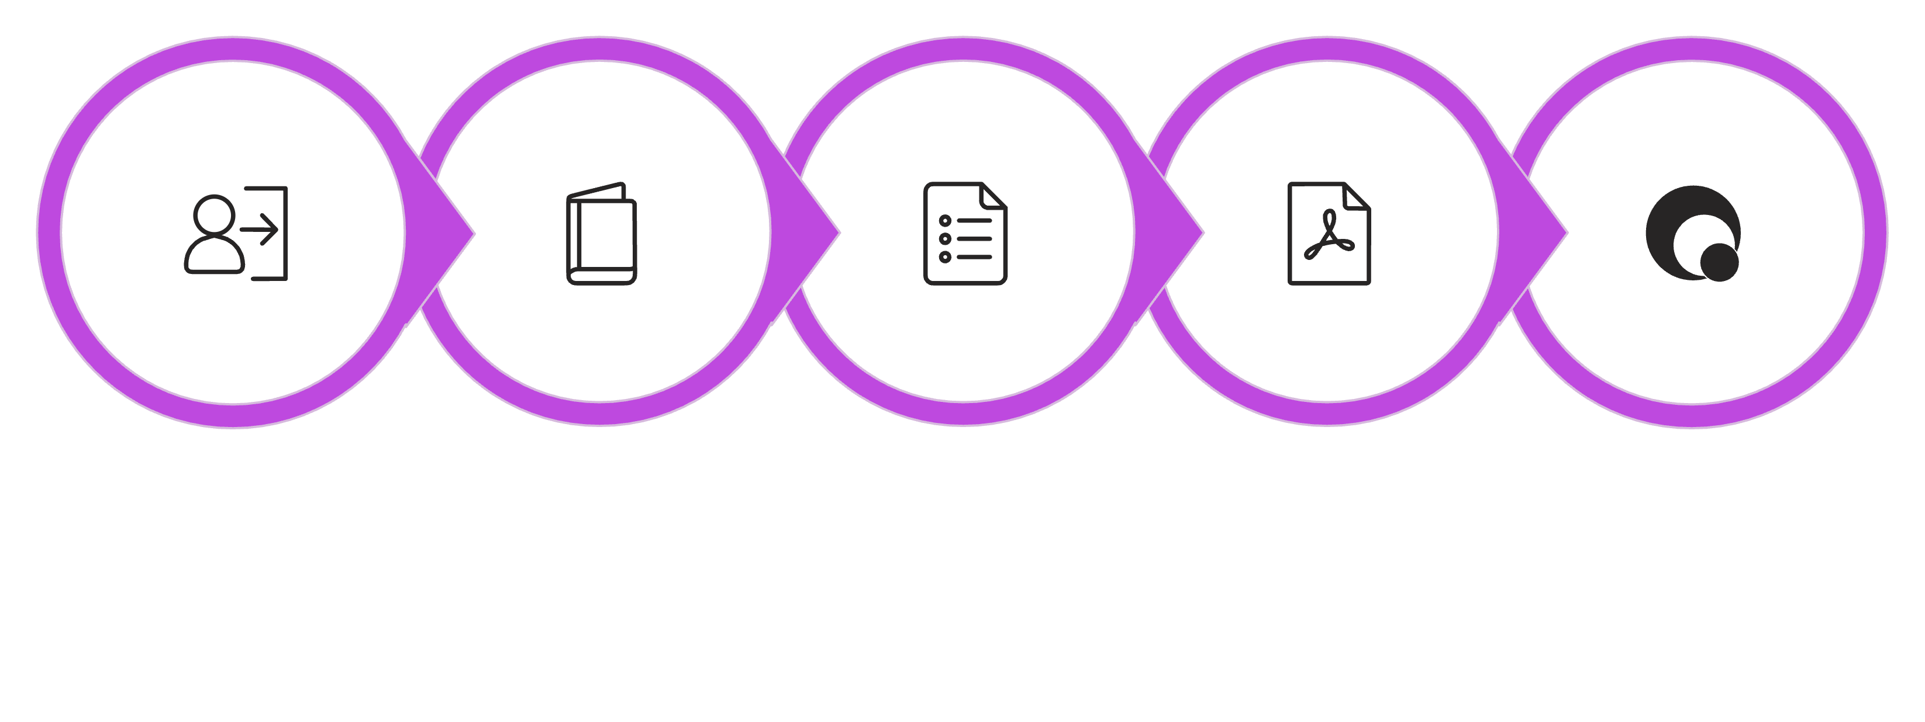
How Path2Learn Works (Workflow)
Login
Select Subject
View Syllabus
Study Topic
Take Quiz
Our intuitive workflow transforms complex syllabi into a clear, engaging, and guided learning experience for every student.

Slide 6





Key Features
Syllabus Transformation
Structured Content
Topic-Wise Quizzes
Progress Dashboard
Automatic conversion of static syllabi into structured, sequential learning topics.
PDF-based learning resources integrated directly into each topic for focused study.
Short, focused quizzes after each topic to reinforce learning and assess comprehension.
A comprehensive dashboard for students to track their progress and performance visually.
Motivation & Guidance
Personalized motivation messages and smart recommendations for the next topics based on performance.

Slide 7

Quiz & Progress Evaluation
Short Multiple-Choice Questions (MCQs) are provided after the completion of each topic.
Evaluation is score-based, offering immediate feedback on understanding.
Achieving a high score unlocks the next topic and provides motivational messages.
Lower scores trigger revision guidance, highlighting areas needing more attention.
This system ensures genuine learning and mastery, moving beyond mere content completion.

Slide 8

Technology Stack
Frontend
HTML, CSS, JavaScript for a responsive and intuitive user interface.
Backend
Python with Flask framework for robust server-side logic and API handling.
Database
MongoDB for flexible and scalable storage of syllabus data, quizzes, and user progress.
Deployment
Docker for containerization, ensuring consistent environments and easy deployment.

Slide 9

Impact & Benefits
Provides students with unparalleled clarity, transforming chaotic syllabi into structured learning paths.
Significantly reduces confusion and academic burnout by streamlining the study process.
Enhances learning consistency and long-term knowledge retention through guided progression and frequent evaluation.
Fosters self-paced and highly motivated learning experiences, adapting to individual student needs.
Ultimately, empowers students to achieve academic success with greater efficiency and less stress.

Slide 10
Future Scope & Conclusion
01
02
AI Quiz Generation
Content Analysis
Automate quiz creation using AI for diverse question types and adaptability.
Advanced PDF content analysis for richer topic extraction and resource linkage.
03
04
Personalised Analytics
Multi-Subject Support
Deeper learning analytics for highly tailored study plans and insights.
Expand to cover multiple subjects and provide comprehensive exam preparation.
Path2Learn transforms static syllabi into smart, motivating learning journeys.

